Slide 1
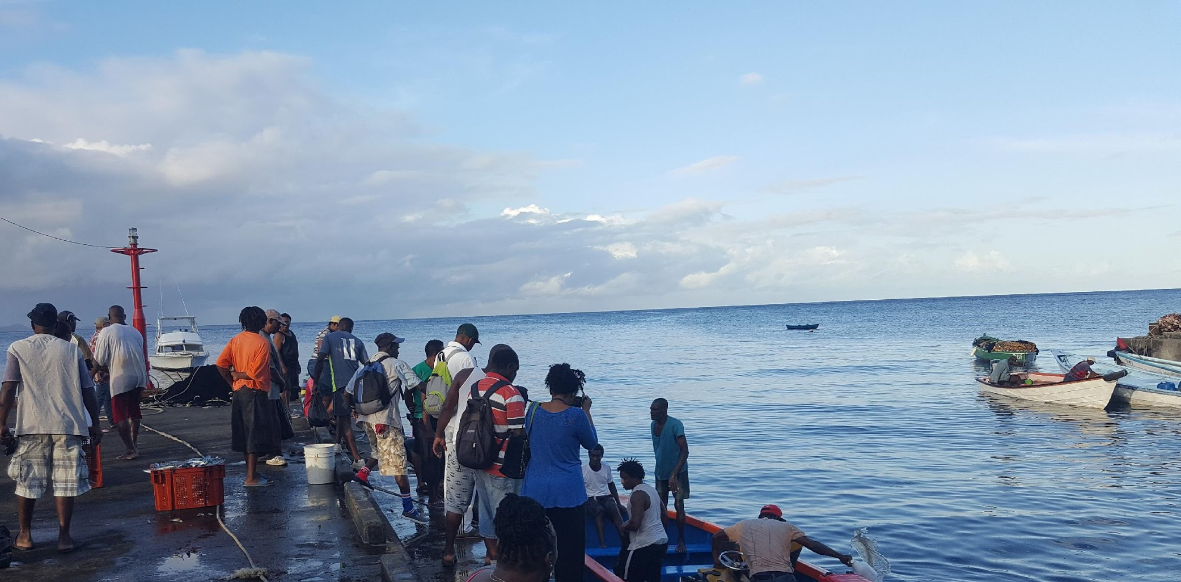
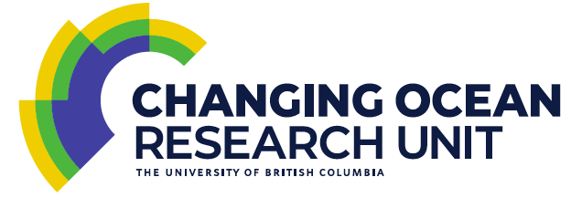
Climate risk adaptation for fish stocks and fisheries production through fisheries management
William W. L. Cheung
Professor
Institute for the Oceans and Fisheries
The University of British Columbia
w.cheung@oceans.ubc.ca
@coru_ubc

Slide 2
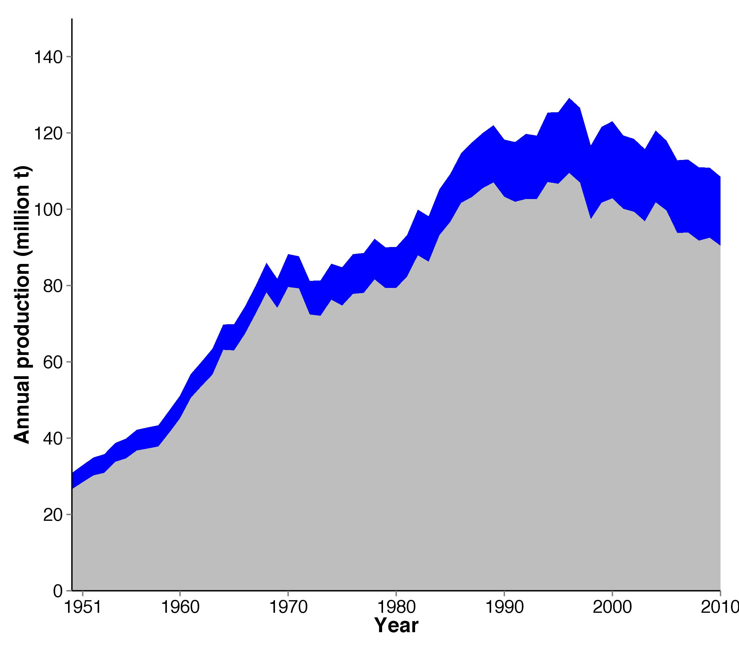
Global seafood production: ‘peak fish’
Invertebrates
Fish
Data source: Pauly & Zeller (2016)
Notes:
Effort is in Gigawatts (per year). Watt is a SI unit of power and is Joules per second. The solar constant includes all types of solar radiation, not just the visible light. It is measured by satellite to be roughly 1.366 kilowatts per square meter (kW/m²) which on average for the whole earth is 1.740×10¹⁷ W (or 1.74 x 10⁸ GW or 174 Million GW)

Slide 3
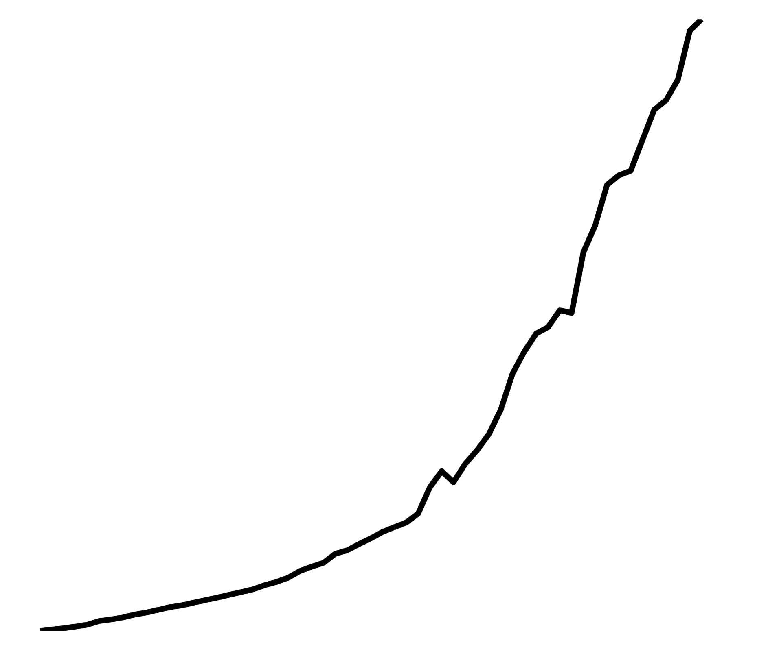
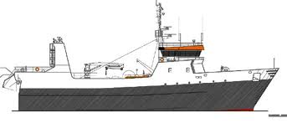
Global fishing effort rises, catch declines
25
~ 30 - 60% of the stocks are over-exploited;
Global catches have declined by ~10% from its peak in the 1990s.
20
Invertebrates
15
Effort (GW or watts x 10⁹)
10
Fish
5
Fishing effort
Data source: Pauly & Zeller (2016); Watson, Cheung et al. (2012); Rousseau et al. (2019)
Notes:
Effort is in Gigawatts (per year). Watt is a SI unit of power and is Joules per second. The solar constant includes all types of solar radiation, not just the visible light. It is measured by satellite to be roughly 1.366 kilowatts per square meter (kW/m²) which on average for the whole earth is 1.740×10¹⁷ W (or 1.74 x 10⁸ GW or 174 Million GW)

Slide 4
Uncertain future seafood availability under climate change
Invertebrates (Capture)
???
Fish (Capture)
Future
Notes:
Effort is in Gigawatts (per year). Watt is a SI unit of power and is Joules per second. The solar constant includes all types of solar radiation, not just the visible light. It is measured by satellite to be roughly 1.366 kilowatts per square meter (kW/m²) which on average for the whole earth is 1.740×10¹⁷ W (or 1.74 x 10⁸ GW or 174 Million GW)

Slide 5
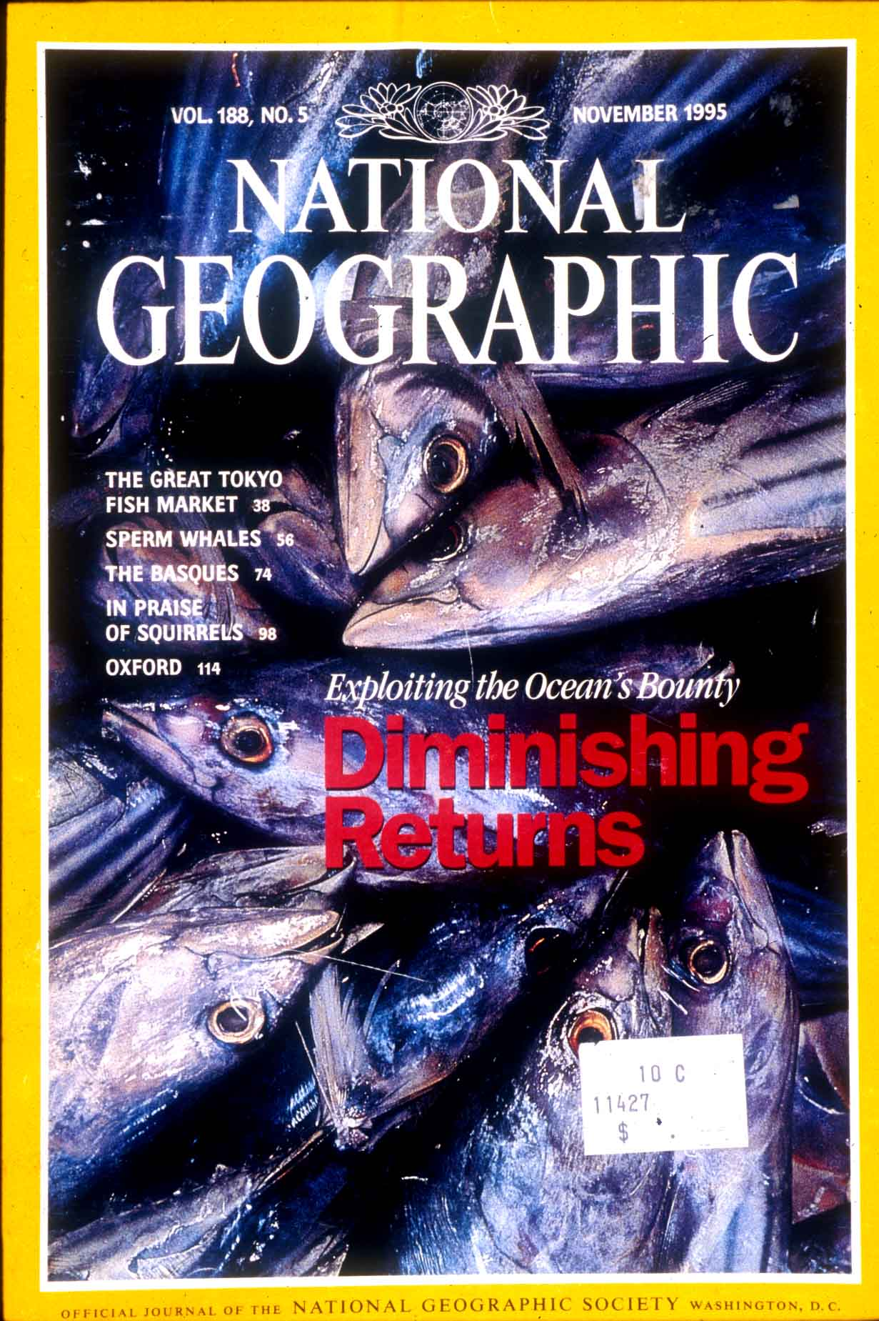
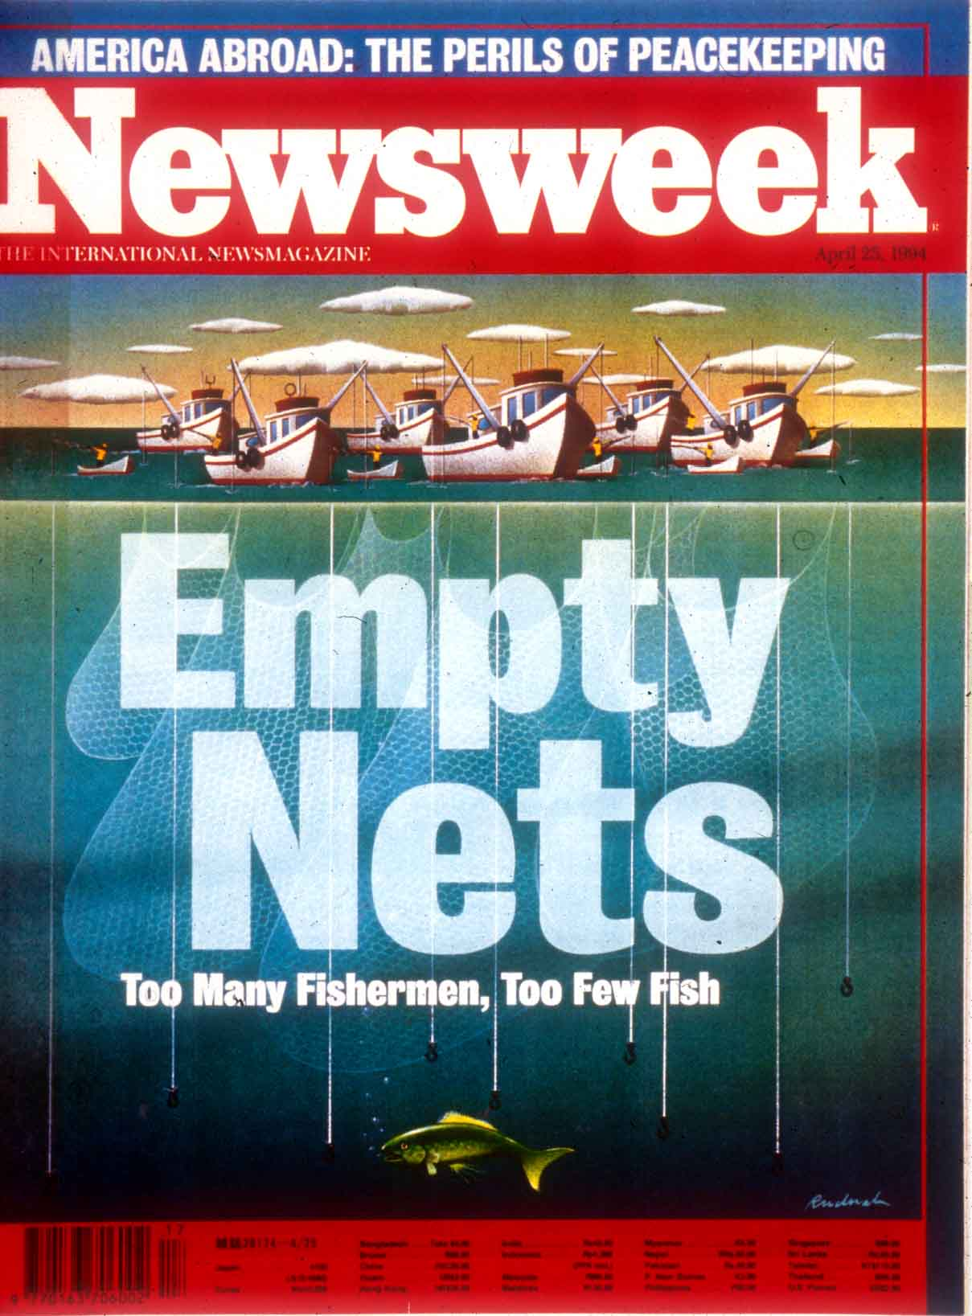
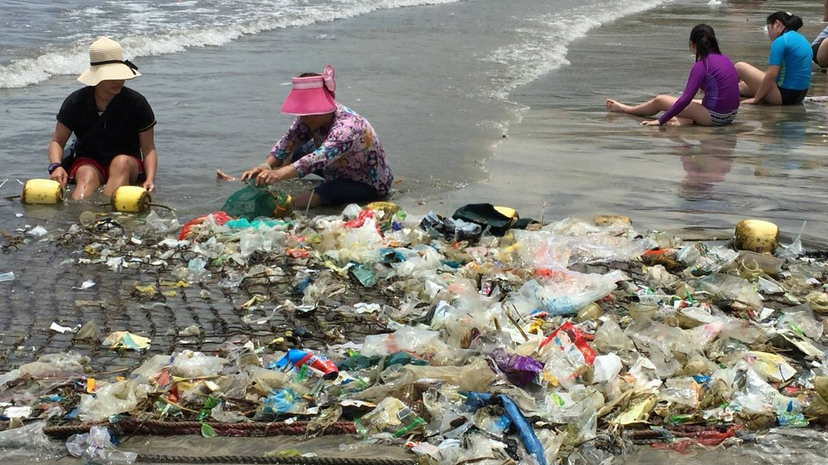
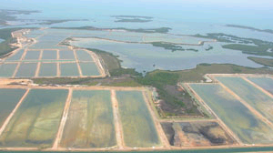
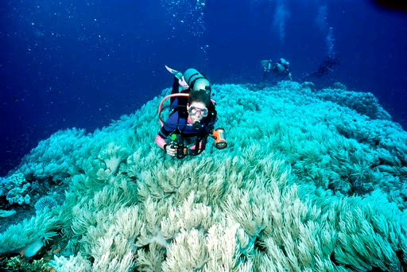
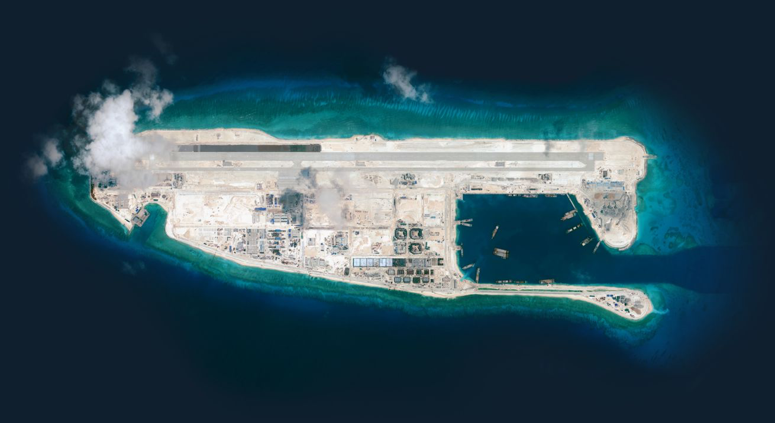
Human impacts on marine ecosystems affecting the capacity to produce fish
Pollution
Climate change
Habitat destruction
Notes:
Marine ecosystems are impacted by a wide range of human activities. I am sure you have read a lot about this from newspaper, magazine or documentary. These human stressors include overfishing, pollution, habitat destruction.

Slide 6
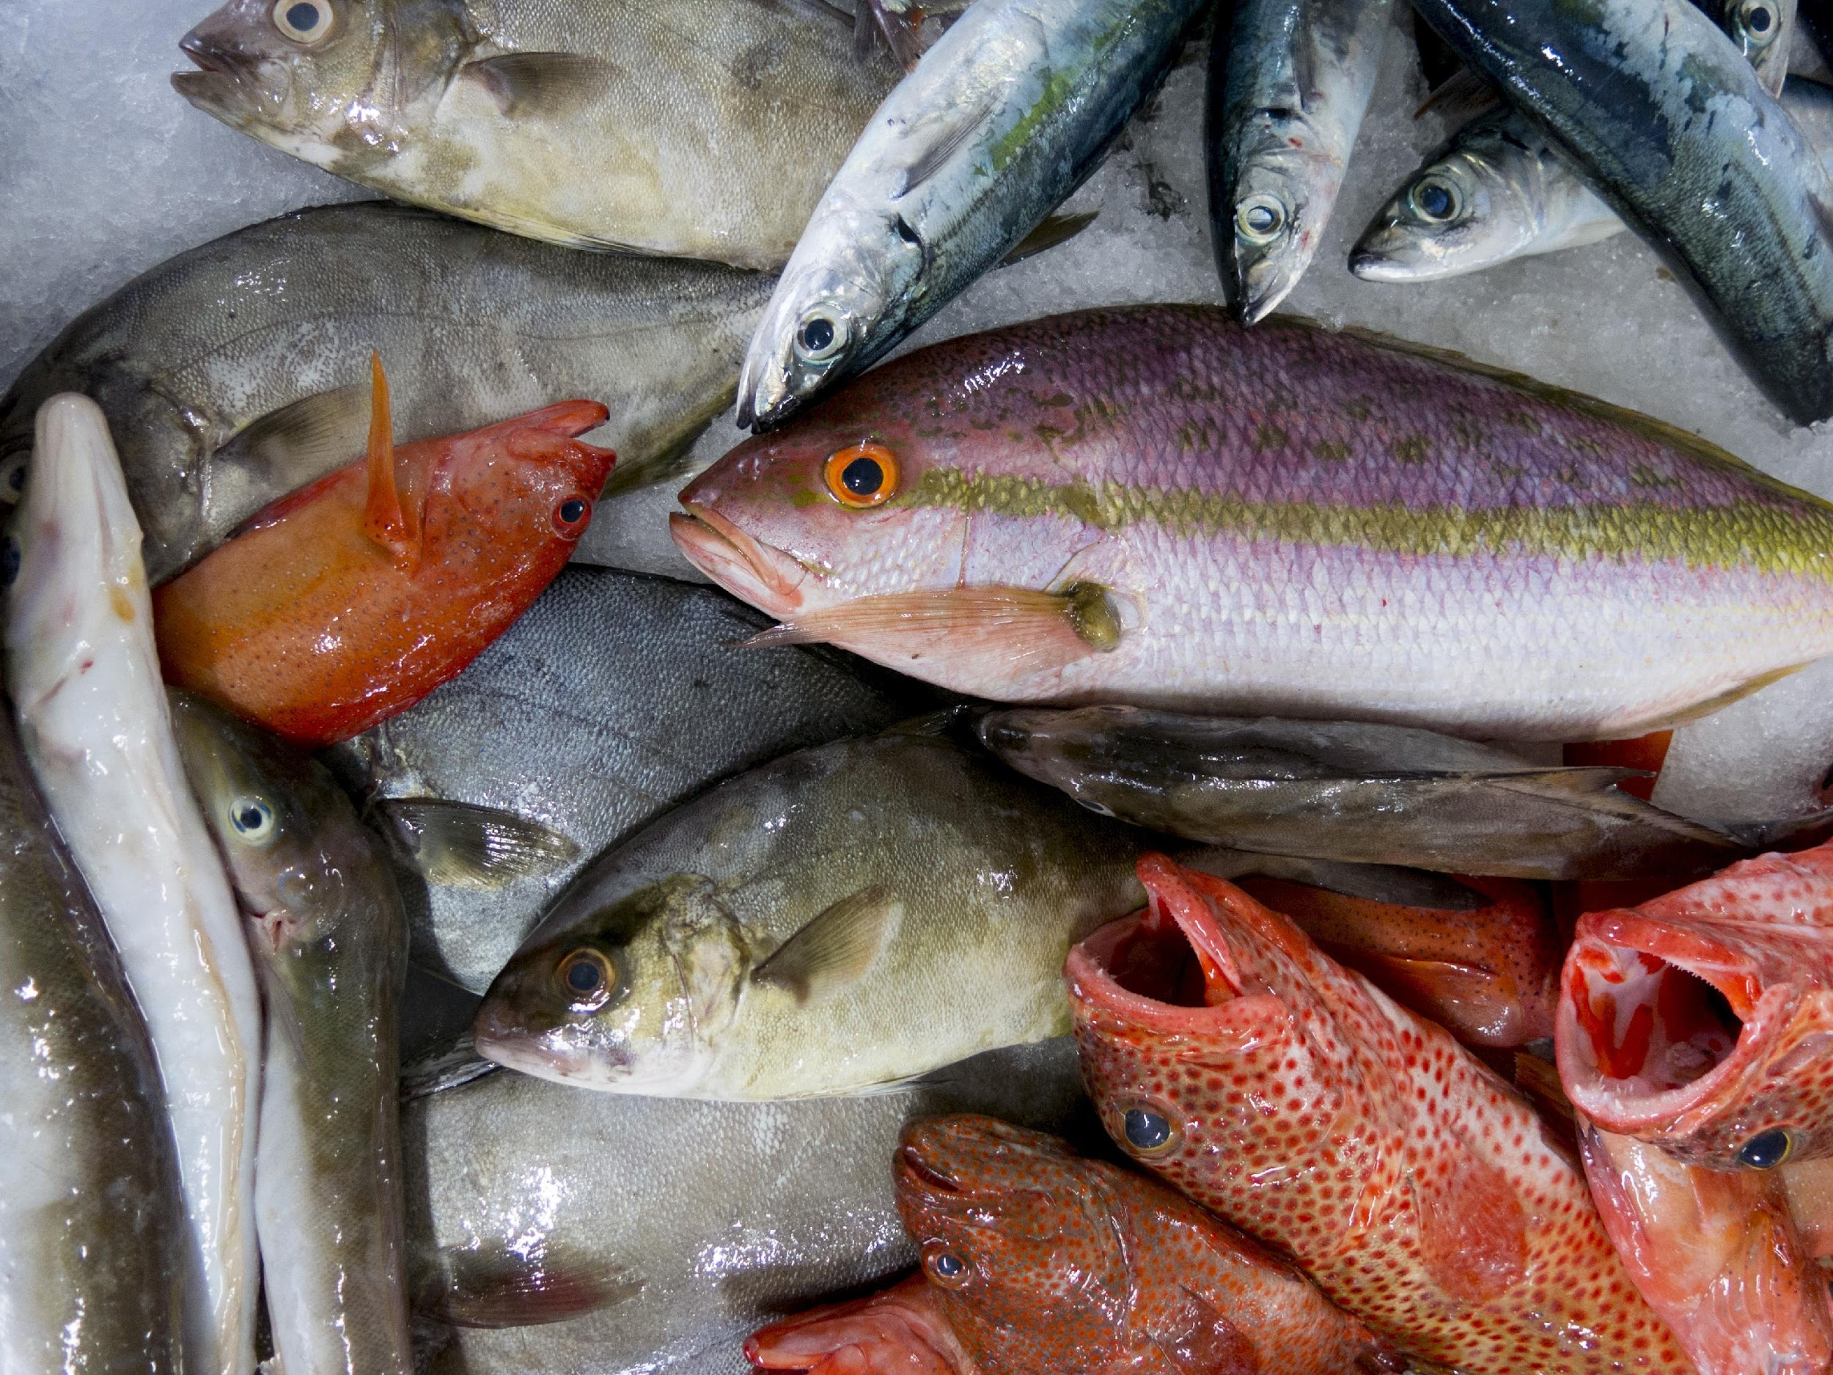
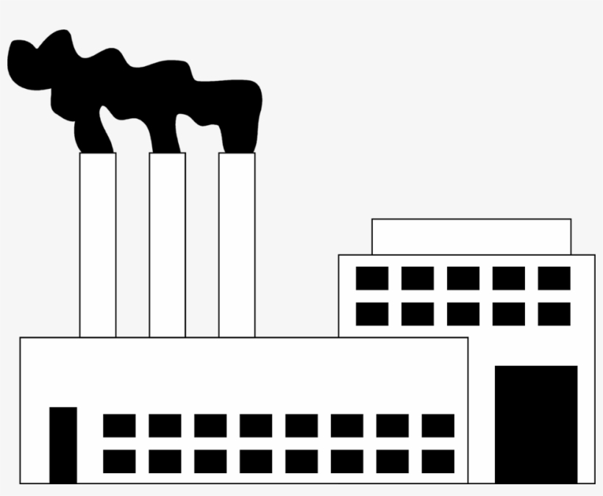
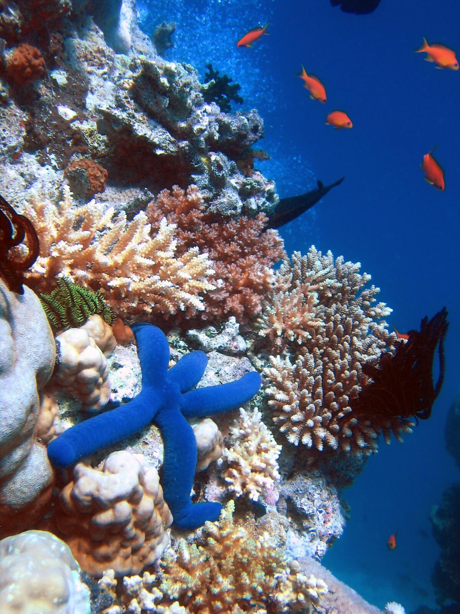
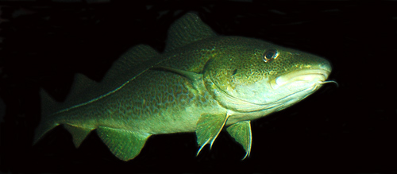
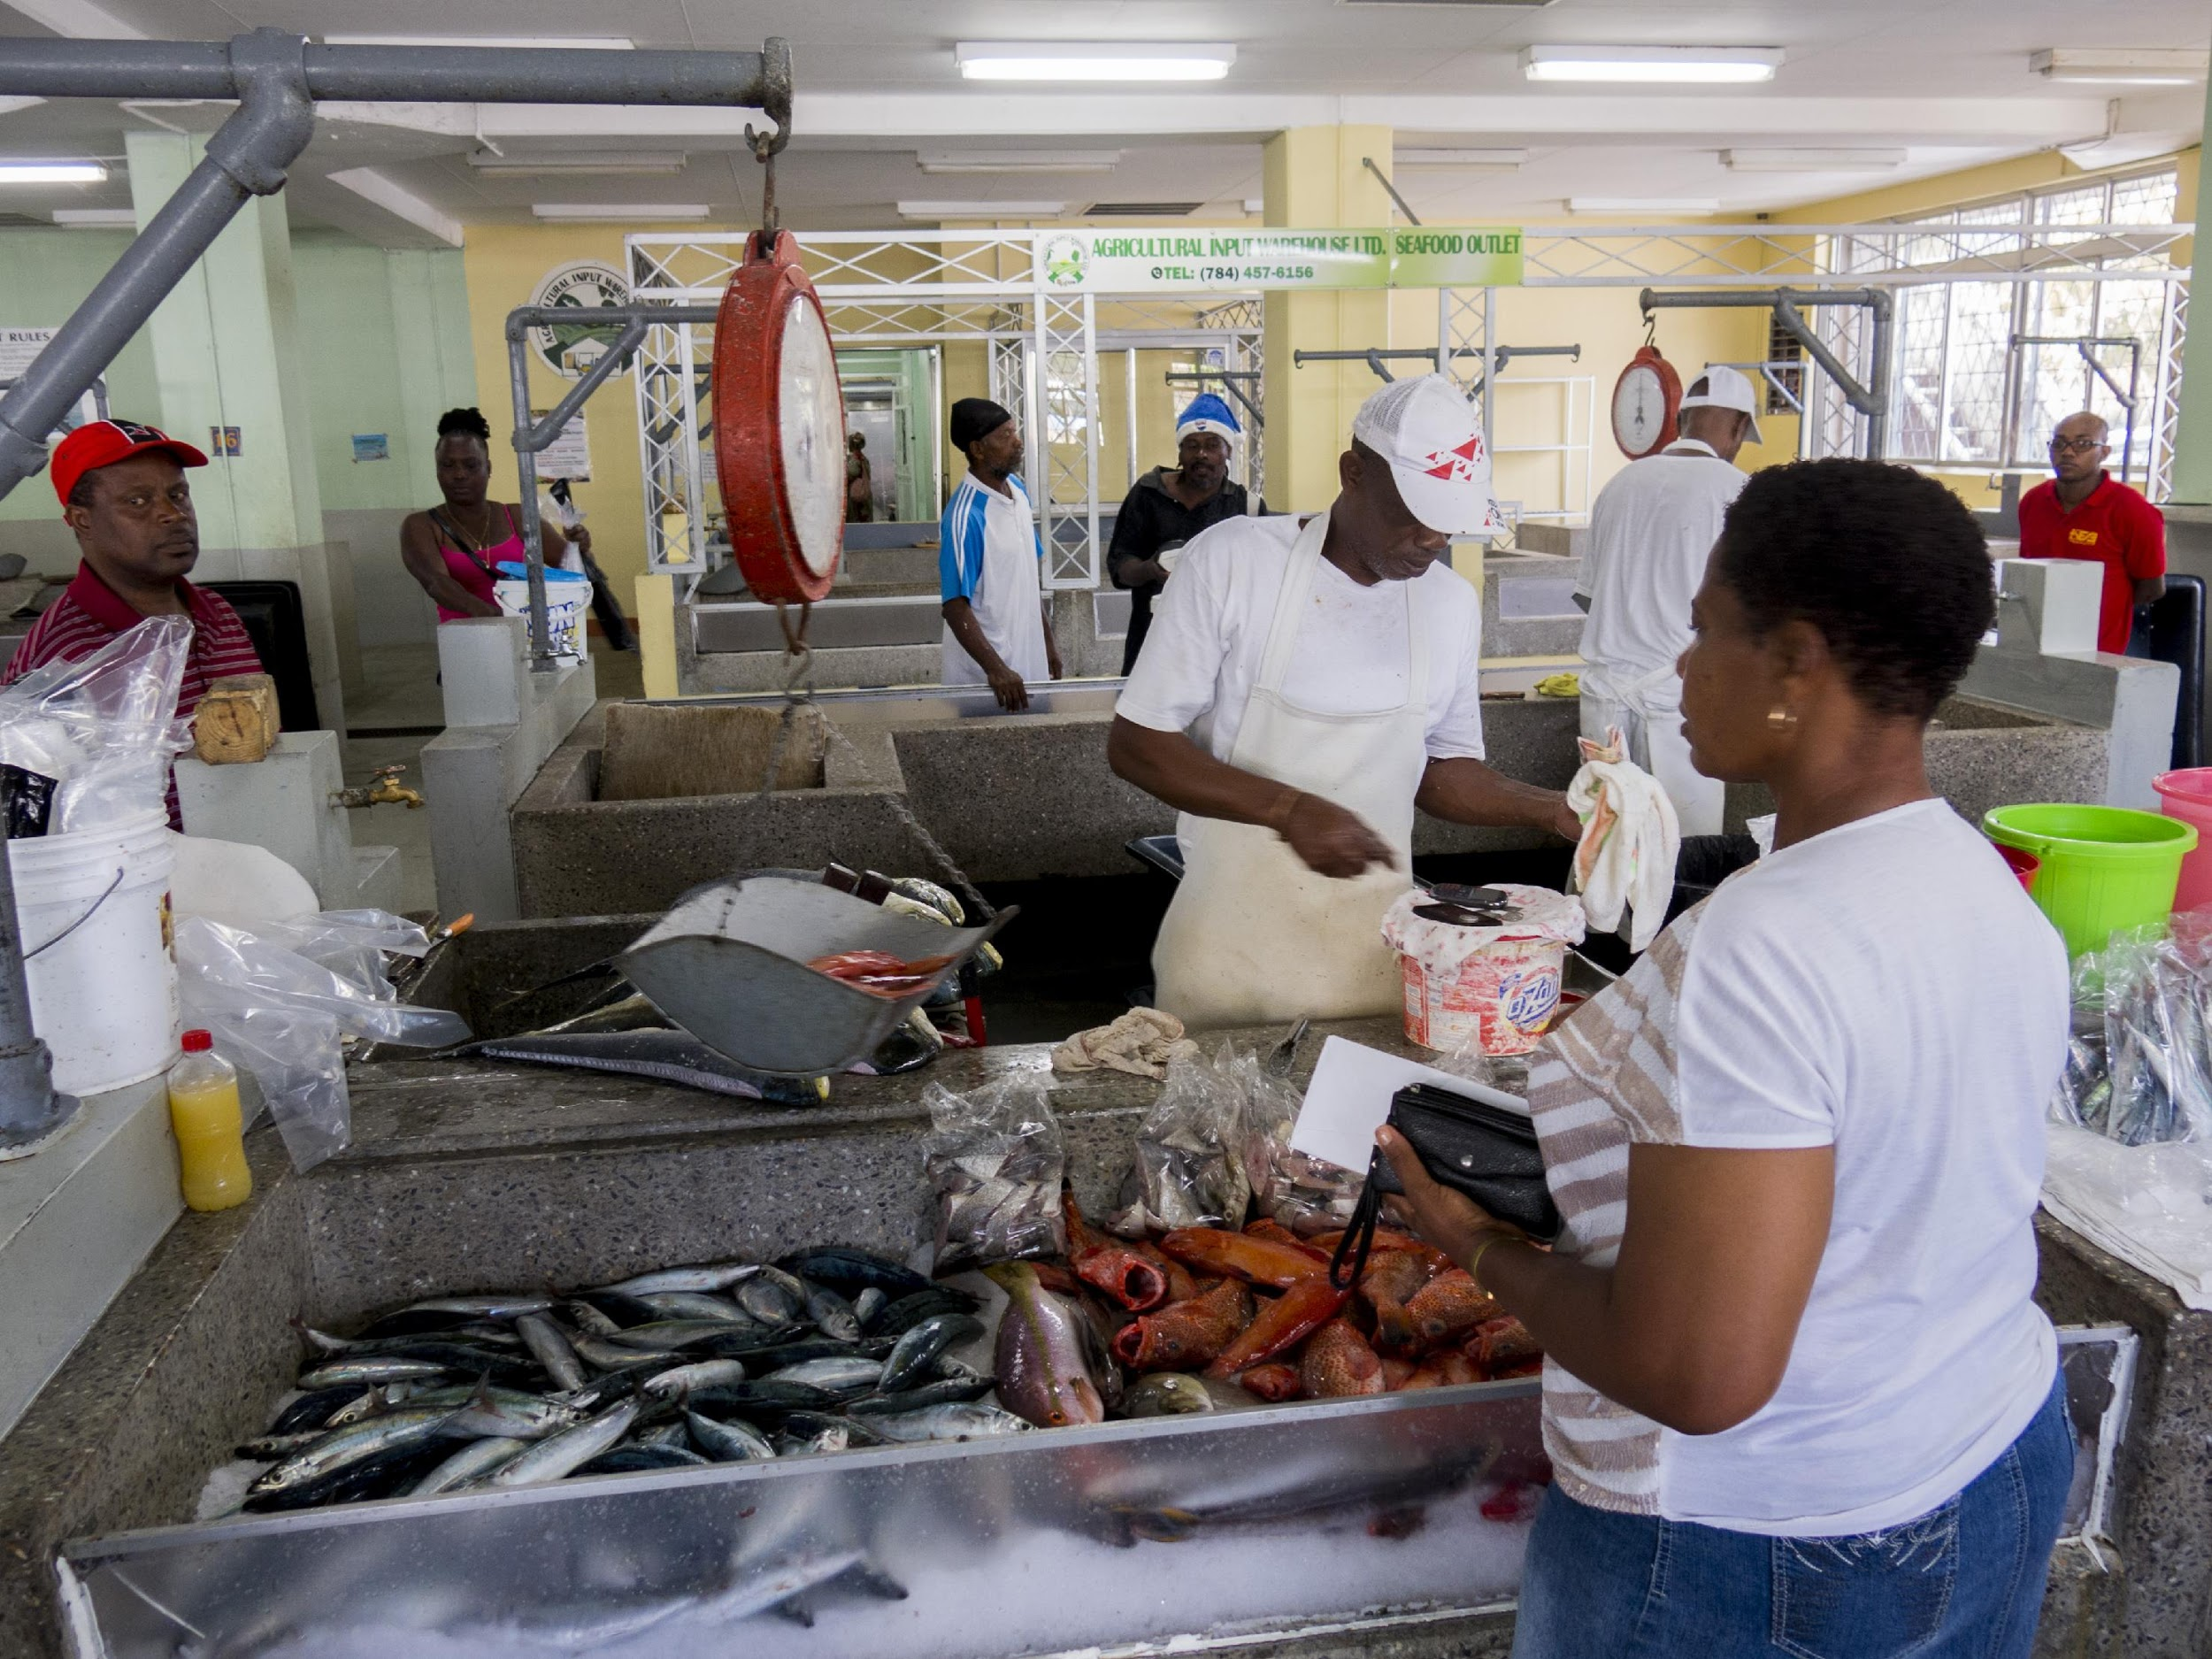
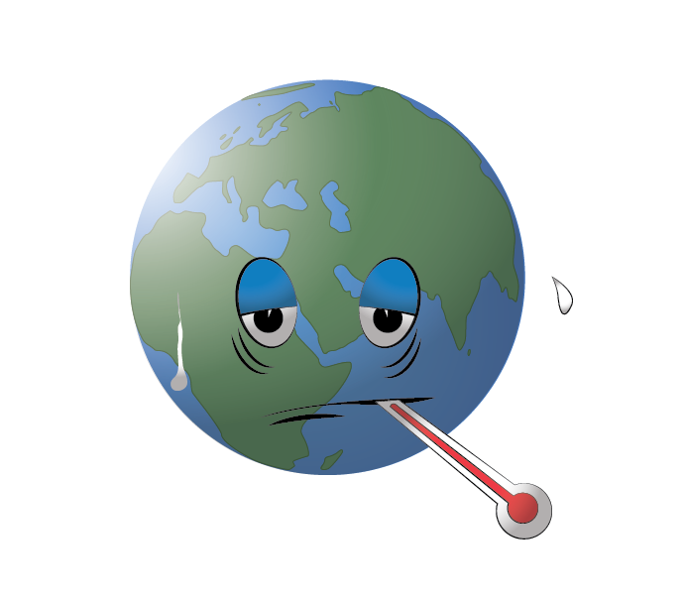
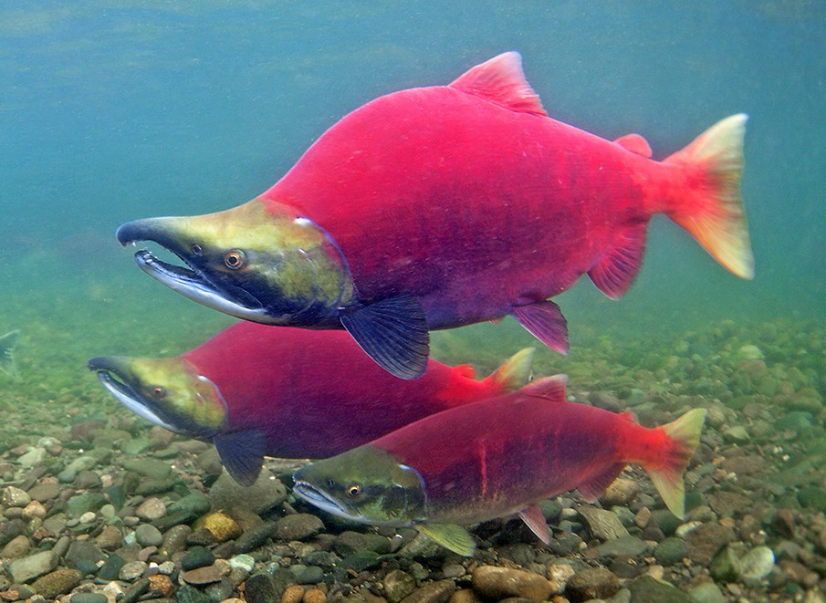
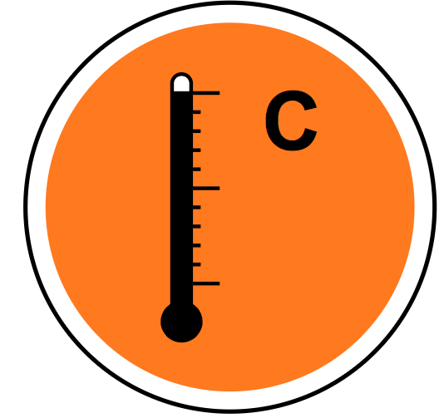
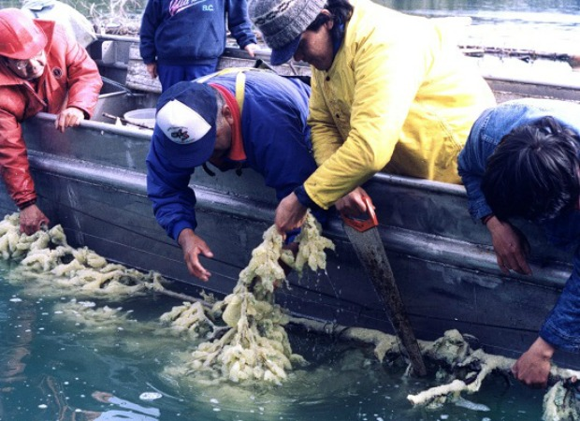
Climate change impacts fish stocks, fisheries and dependent human communities
Fish/invertebrates
CO₂
Food
Livelihood
Ocean
Temperature
Oxygen
Acidity
Culture

Slide 7
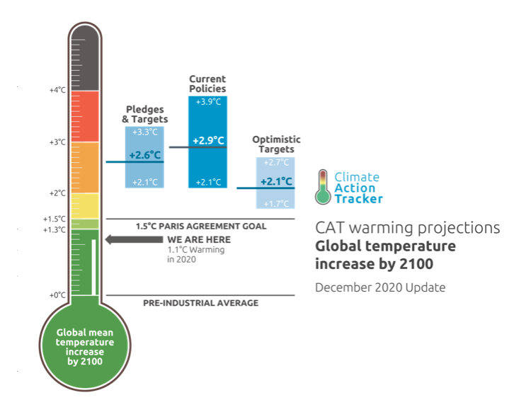
Projected climate impacts on fisheries depends on mitigation
Climate mitigation targets and current trajectory
Maximum catch potential
3,400,000 tonne ºC⁻¹
Paris Agreement
Low mitigation
Source: https://climateactiontracker.org/
Global mean warming (ºC)
Cheung, Reygondeau, Frölicher (2016) Science
Notes:
In fact, if we look at the changes in catch potential by region, some of the “winners” in ocean warming may become “losers” if ocean acidification and dexoygenation are considered. In the global map that I show you earlier, the North Atlantic is shown to be a winder. These are the different region in the Northeast Atlantic, such as the Barent Sea, Greenland, Nowegainsea, North Sea, Baltic Sea. The back bar represent no acidication effect while the white bar represent high impact of ocean acidification and deoxygenation. For example, if you look at the Celtic Shelft, warming only is expectd to lead to a slight increase in potential catch and acidificiation and deoxygenation are expected to turn the region to a loss in potential catch in the future.

Slide 8
Projected climate impacts on fisheries depends on mitigation
Climate mitigation targets and current trajectory
Maximum catch potential
Decrease 3,400,000 tonne per ºC
Change in catch potential (%)
Paris Agreement
Low mitigation
Source: https://climateactiontracker.org/
Global mean warming (ºC)
Cheung, Reygondeau, Frölicher (2016) Science
Notes:
In fact, if we look at the changes in catch potential by region, some of the “winners” in ocean warming may become “losers” if ocean acidification and dexoygenation are considered. In the global map that I show you earlier, the North Atlantic is shown to be a winder. These are the different region in the Northeast Atlantic, such as the Barent Sea, Greenland, Nowegainsea, North Sea, Baltic Sea. The back bar represent no acidication effect while the white bar represent high impact of ocean acidification and deoxygenation. For example, if you look at the Celtic Shelft, warming only is expectd to lead to a slight increase in potential catch and acidificiation and deoxygenation are expected to turn the region to a loss in potential catch in the future.

Slide 9
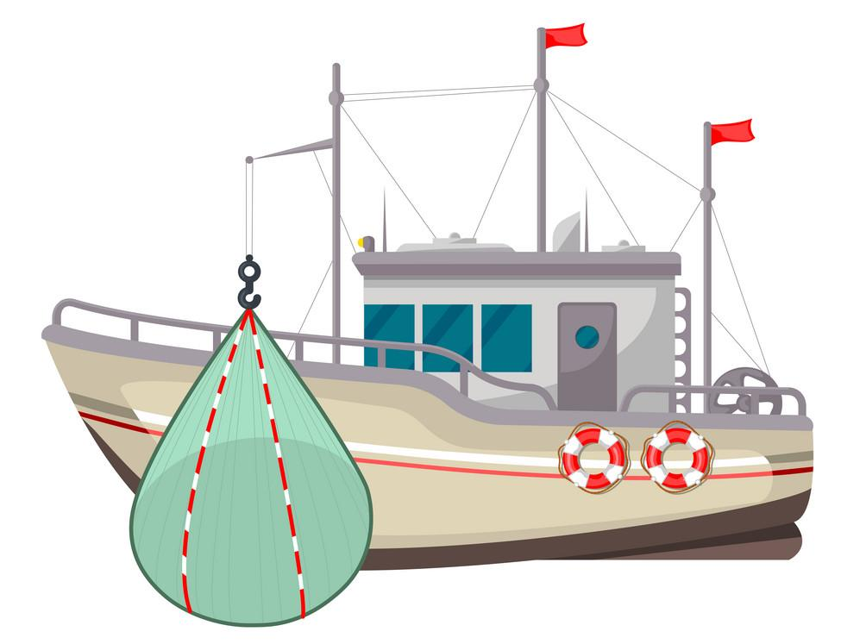
How eliminating overfishing can help adapt climate change impacts on fisheries production?
Overfishing
Sustainable fishing
_{Sustainable fishing}
_{Over-fishing}
_{Climate change}
_{Climate change}
Decrease in catches
Increase in catches

Slide 10
How eliminating overfishing can help adapt climate change impacts on fisheries production?
Maximum catch potential
Sustainable fishing
Overfishing
Present day
Stronger mitigation
Weak mitigation
Global mean warming (ºC)
Notes:
The projected changes are not uniform around the world. Some areas are more affected e.g., tropical region.
Decrease in availability of fish threatens nutritional security of some coastal communities, esp in tropical developing country regions such as west Africa and indo-pacific region

Slide 11
Eliminating over-fishing increases fish stock abundance and catches, and helps partly offset climate impacts.
Minimum target: maintain current catch level
Maximum catch potential
Sustainable fishing
Overfishing
Present day
Stronger mitigation
Weak mitigation
Global mean warming (ºC)
Notes:
The projected changes are not uniform around the world. Some areas are more affected e.g., tropical region.
Decrease in availability of fish threatens nutritional security of some coastal communities, esp in tropical developing country regions such as west Africa and indo-pacific region

Slide 12
Eliminating over-fishing increases fish stock abundance and catches, and help partly offset climate impacts.
Minimum target: maintain current catch level
Maximum catch potential
Sustainable fishing
Overfishing
Present day
Stronger mitigation
Weak mitigation
Global mean warming (ºC)
Notes:
The projected changes are not uniform around the world. Some areas are more affected e.g., tropical region.
Decrease in availability of fish threatens nutritional security of some coastal communities, esp in tropical developing country regions such as west Africa and indo-pacific region

Slide 13
However, there are limits to the extent of climate risk adaptation.
Limit to adaptation
Un-adapted impacts
Maximum catch potential
Sustainable fishing
Overfishing
Present day
Stronger mitigation
Weak mitigation
Global mean warming (ºC)
Notes:
The projected changes are not uniform around the world. Some areas are more affected e.g., tropical region.
Decrease in availability of fish threatens nutritional security of some coastal communities, esp in tropical developing country regions such as west Africa and indo-pacific region

Slide 14
Also, if present-day fish stocks are already fully-exploited, or the fisheries are targeting for higher catches than the present-day
More ambitious target
Maximum catch potential
Sustainable fishing
Overfishing
Present day
Stronger mitigation
Weak mitigation
Global mean warming (ºC)
Notes:
The projected changes are not uniform around the world. Some areas are more affected e.g., tropical region.
Decrease in availability of fish threatens nutritional security of some coastal communities, esp in tropical developing country regions such as west Africa and indo-pacific region

Slide 15
Also, if present-day fish stocks are already fully-exploited, or the fisheries are targeting for higher catches than the present-day
Limit to adaptation
More ambitious target
Maximum catch potential
Sustainable fishing
Overfishing
Present day
Stronger mitigation
Weak mitigation
Global mean warming (ºC)
Notes:
The projected changes are not uniform around the world. Some areas are more affected e.g., tropical region.
Decrease in availability of fish threatens nutritional security of some coastal communities, esp in tropical developing country regions such as west Africa and indo-pacific region

Slide 16
There will be stronger limit to adaptation to achieve its target and more ambitious climate mitigation is need.
Limit to adaptation
More ambitious target
Maximum catch potential
Sustainable fishing
Overfishing
Present day
Stronger mitigation
Weak mitigation
Global mean warming (ºC)
Notes:
The projected changes are not uniform around the world. Some areas are more affected e.g., tropical region.
Decrease in availability of fish threatens nutritional security of some coastal communities, esp in tropical developing country regions such as west Africa and indo-pacific region

Slide 17
There will be stronger limit to adaptation to achieve its target and more ambitious climate mitigation is need.
Limit to adaptation
More ambitious target
Maximum catch potential
Sustainable fishing
Overfishing
Present day
Stronger mitigation
Weak mitigation
Global mean warming (ºC)
Notes:
The projected changes are not uniform around the world. Some areas are more affected e.g., tropical region.
Decrease in availability of fish threatens nutritional security of some coastal communities, esp in tropical developing country regions such as west Africa and indo-pacific region

Slide 18
Limit to adaptation and the level of un-adapted impacts are bigger for more climate-sensitive fishereis
Limit to adaptation
Maximum catch potential
Sustainable fishing
Overfishing
Present day
Stronger mitigation
Weak mitigation
Global mean warming (ºC)
Notes:
The projected changes are not uniform around the world. Some areas are more affected e.g., tropical region.
Decrease in availability of fish threatens nutritional security of some coastal communities, esp in tropical developing country regions such as west Africa and indo-pacific region

Slide 19
Limit to adaptation and the level of un-adapted impacts are bigger for more climate-sensitive fishereis
Limit to adaptation
Un-adapted impacts
Maximum catch potential
Sustainable fishing
Overfishing
Present day
Stronger mitigation
Weak mitigation
Global mean warming (ºC)
Notes:
The projected changes are not uniform around the world. Some areas are more affected e.g., tropical region.
Decrease in availability of fish threatens nutritional security of some coastal communities, esp in tropical developing country regions such as west Africa and indo-pacific region

Slide 20
Modelling and data analysis
Source: https://www.techrepublic.com/article/why-your-data-analysis-may-be-doomed-from-the-start/
Notes:
The projected changes are not uniform around the world. Some areas are more affected e.g., tropical region.
Decrease in availability of fish threatens nutritional security of some coastal communities, esp in tropical developing country regions such as west Africa and indo-pacific region

Slide 21
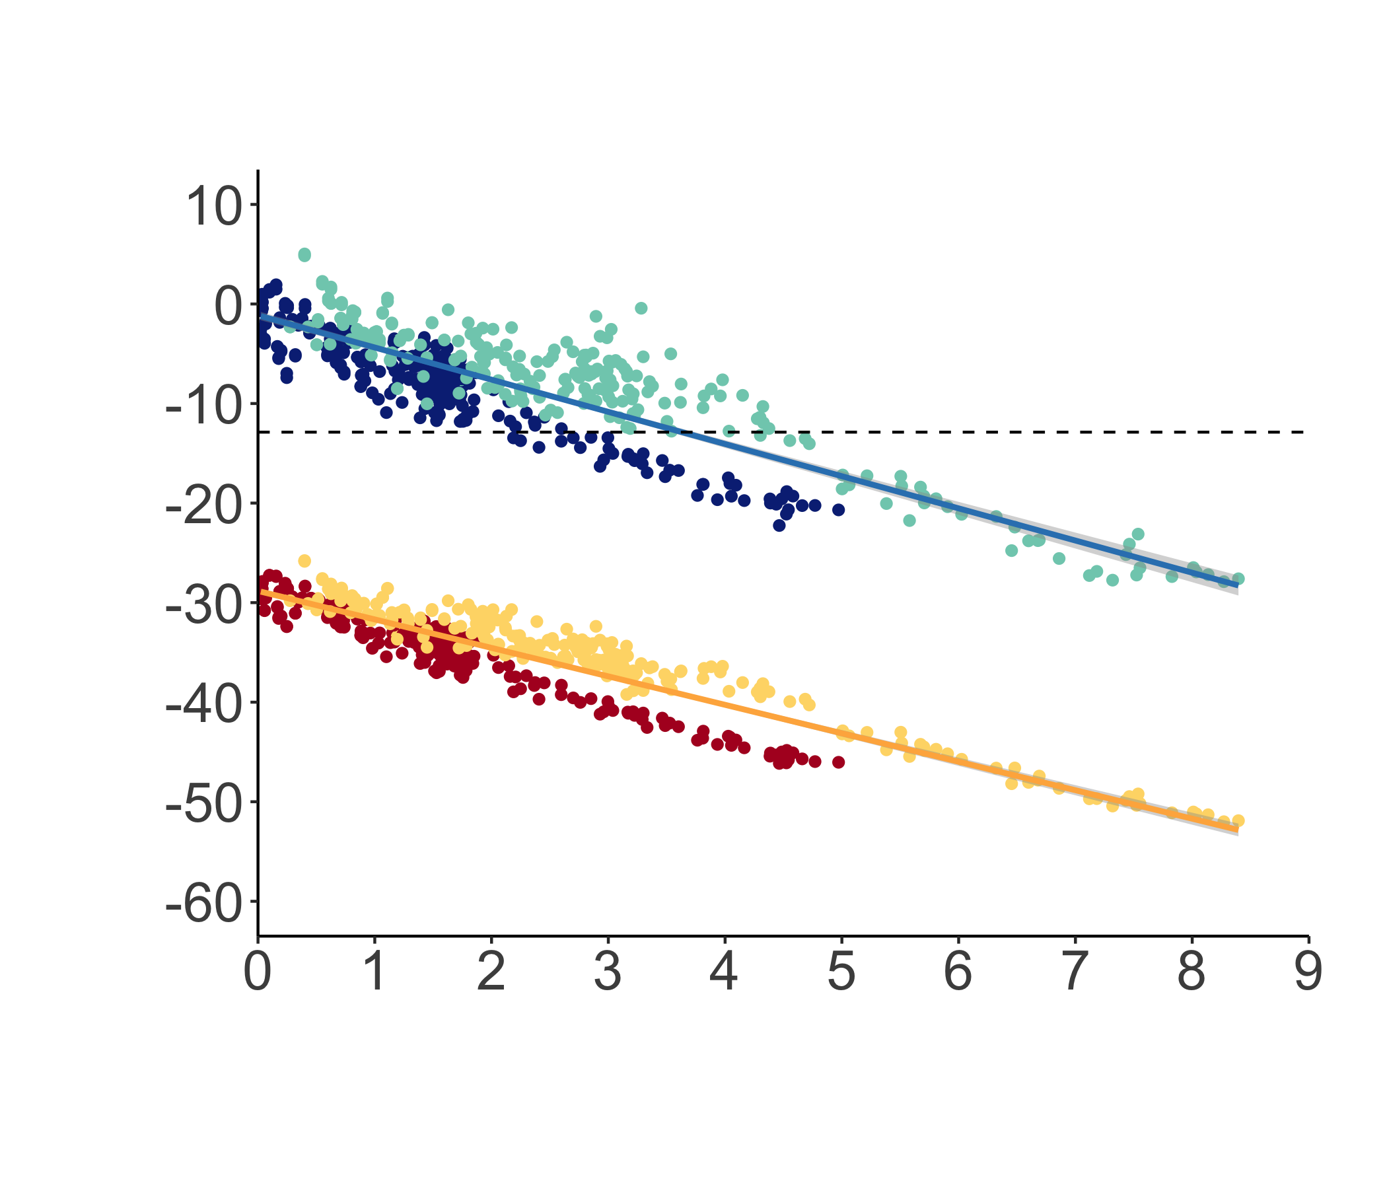
Global catches are ~90% of the maximum catch potential; ‘dynamic’ fisheries management at maximum sustainable yield (MSY) can adapt to 3.5-4.0 ºC warming relative to pre-industrial level
Limit to adaptation
Change in catch potential (%)
Fishing at MSY
2 x fishing required for MSY
Present day
Global mean warming (ºC)
Cheung et al. (in prep.)
Notes:
In fact, if we look at the changes in catch potential by region, some of the “winners” in ocean warming may become “losers” if ocean acidification and dexoygenation are considered. In the global map that I show you earlier, the North Atlantic is shown to be a winder. These are the different region in the Northeast Atlantic, such as the Barent Sea, Greenland, Nowegainsea, North Sea, Baltic Sea. The back bar represent no acidication effect while the white bar represent high impact of ocean acidification and deoxygenation. For example, if you look at the Celtic Shelft, warming only is expectd to lead to a slight increase in potential catch and acidificiation and deoxygenation are expected to turn the region to a loss in potential catch in the future.

Slide 22
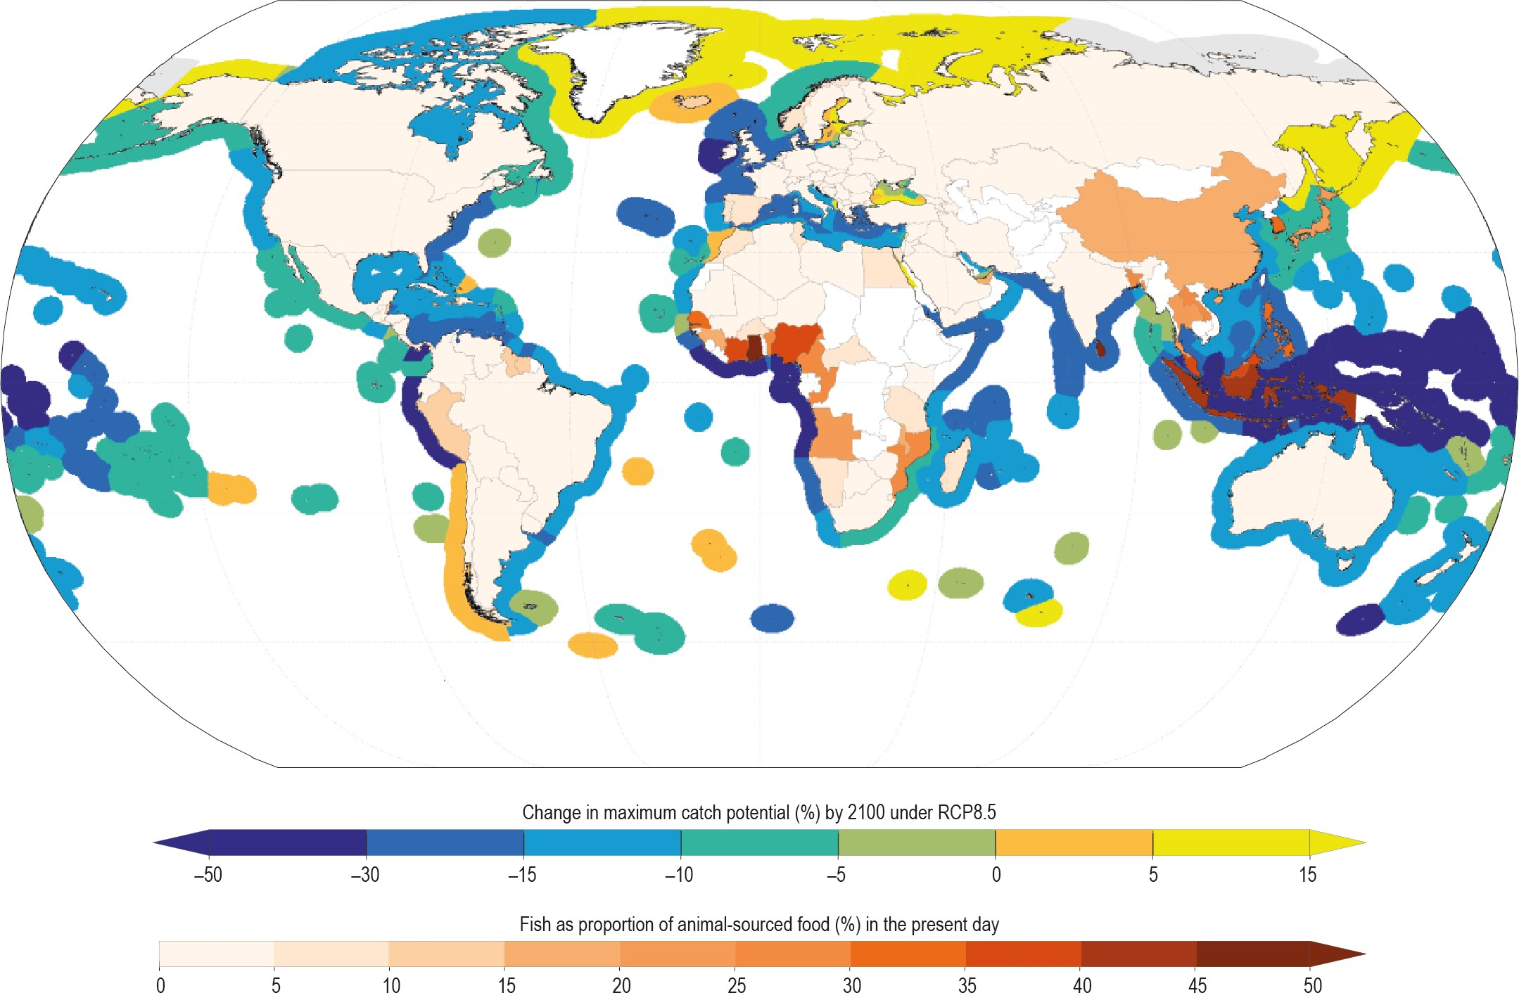
Fisheries in tropical region e.g., Indo-Pacific Ocean are projected to be most heavily impacted by climate change.
Change in maximum catch potential (%) by 2100 under RCP8.5
Fish as proportion of animal-sourced food (%) in present day
Bindoff, Cheung et al. (2019) IPCC SROCC
Notes:
The projected changes are not uniform around the world. Some areas are more affected e.g., tropical region.
Decrease in availability of fish threatens nutritional security of some coastal communities, esp in tropical developing country regions such as west Africa and indo-pacific region

Slide 23
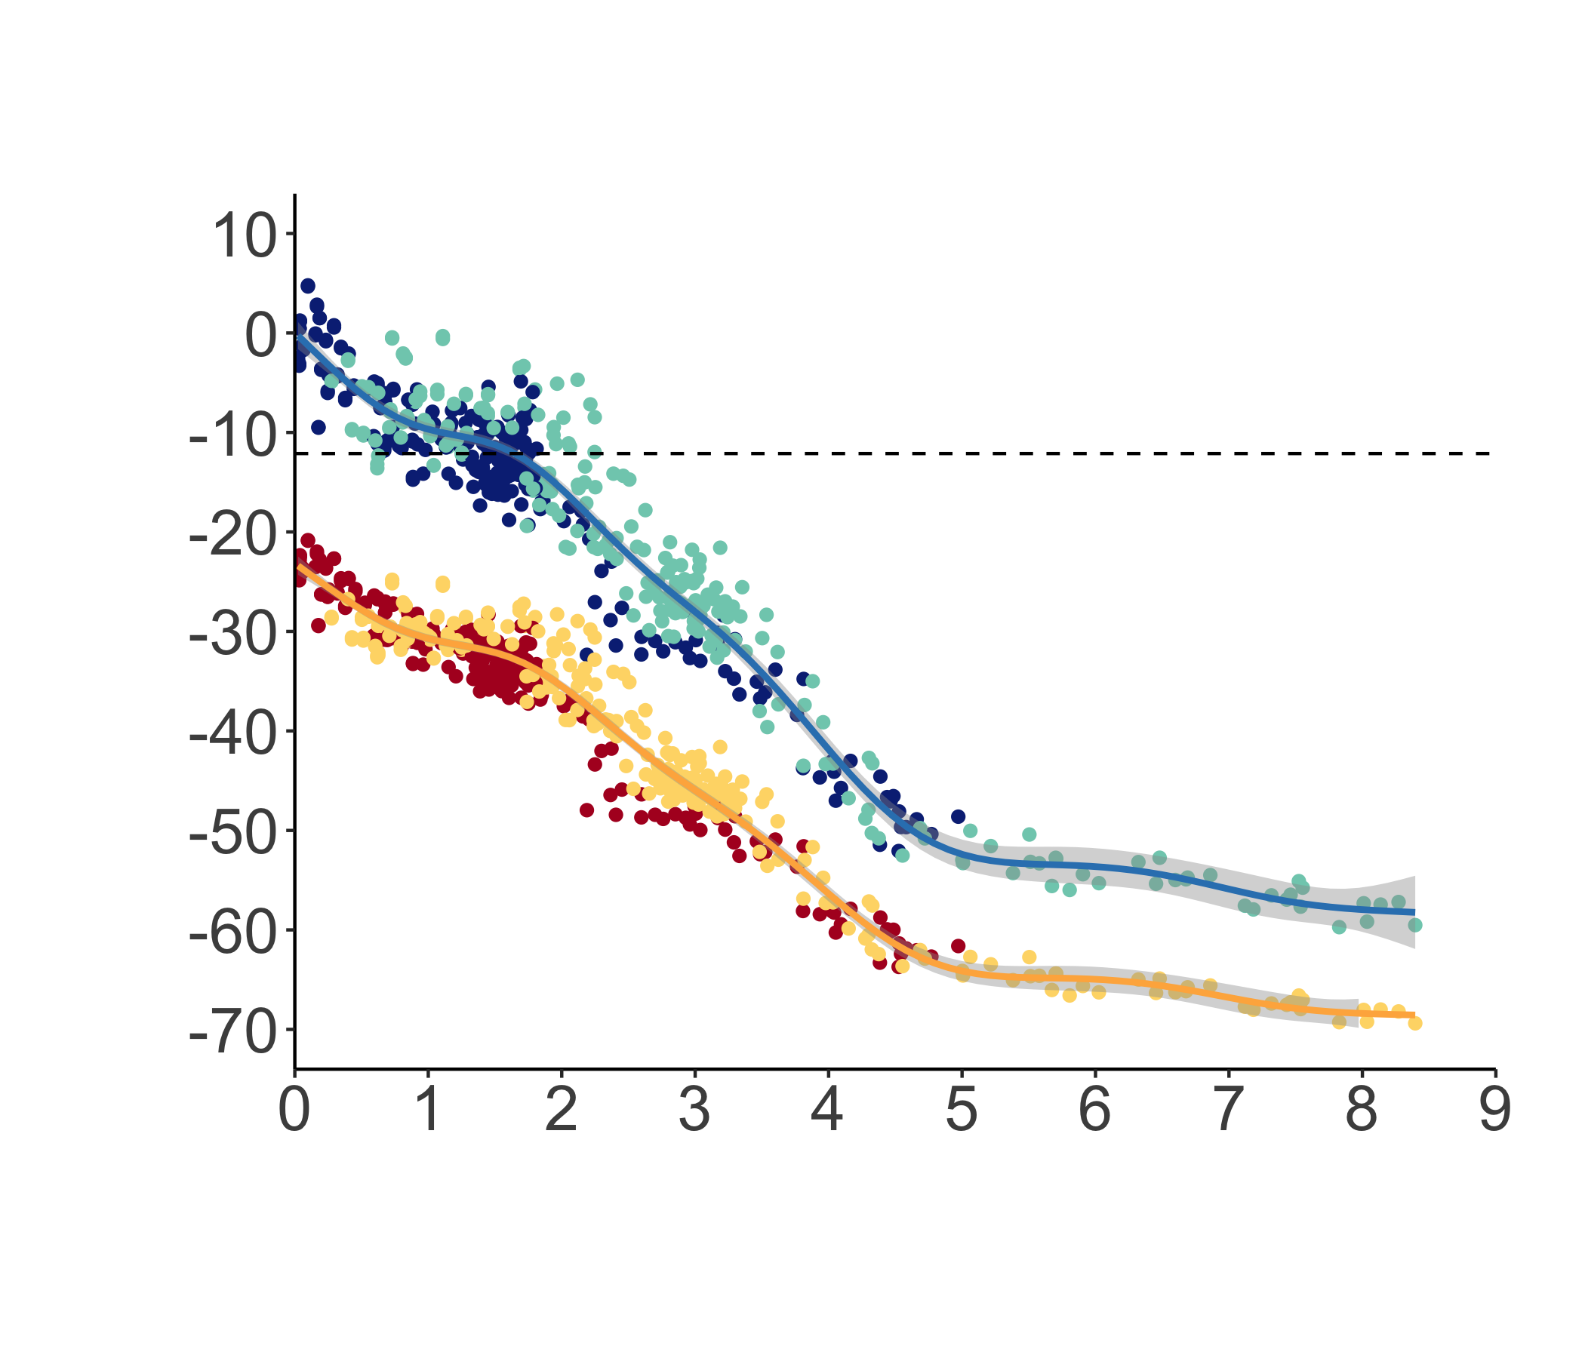
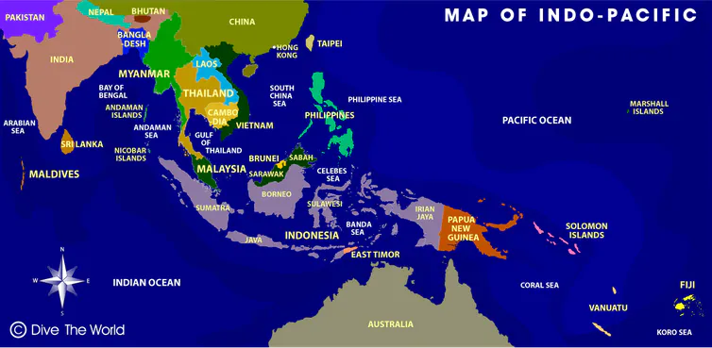
Indo-Pacific regions: achieving the Paris Agreement (limiting warming to 1.5 ºC) and sustainable fisheries are necessary to maintain current fisheries production
Limit to adaptation
Change in catch potential (%)
Fishing at MSY
2 x fishing required for MSY
Present day
Global mean warming (ºC)
Cheung et al. (in prep.)
Notes:
In fact, if we look at the changes in catch potential by region, some of the “winners” in ocean warming may become “losers” if ocean acidification and dexoygenation are considered. In the global map that I show you earlier, the North Atlantic is shown to be a winder. These are the different region in the Northeast Atlantic, such as the Barent Sea, Greenland, Nowegainsea, North Sea, Baltic Sea. The back bar represent no acidication effect while the white bar represent high impact of ocean acidification and deoxygenation. For example, if you look at the Celtic Shelft, warming only is expectd to lead to a slight increase in potential catch and acidificiation and deoxygenation are expected to turn the region to a loss in potential catch in the future.

Slide 24
PORTFOLIO OF SOLUTIONS IS NEEDED

Slide 25
Summary
Eliminating overfishing is a ‘no regret’ climate solution i.e., with strong co-benefits;
Important to recognize the limits to adaptation, particularly in tropical regions;
Portfolio of solutions are necessary, including strong mitigation through transformation to low carbon society, sustainable fisheries management and other nature-based solutions.

Slide 26
Thank you
All the collaborators

Slide 27
What does CO₂ emission do to the ocean?
Ocean warming has more than doubled;
Marine heatwaves have doubled in frequency;
Ocean acidification is intensifying as more CO₂, is absorbed;
Oxygen minimum zones expanded by 3-8%;
Sea surface temperature
Ocean acidification
Marine heatwaves
Oxygen content
Year
IPCC (2019) SROCC SPM

Slide 28
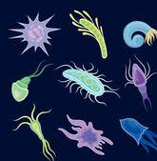
Other climate benefits from stock rebuilding, e.g., restoring carbon sequestration potential of large pelagic predators
CO₂
43.5% of the carbon extracted by fishing large ocean predators comes from areas that would be economically unprofitable without ‘harmful’ fisheries subsidies.
Plankton
Dead body
(Carbon)
X
Mariani, Cheung…Mouillot (2020).. Sci. Adv. 6 (2020), doi:10.1126/sciadv.abb4848.

