Slide 1
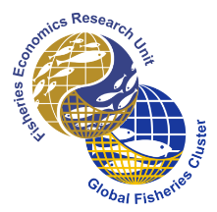
End overfishing & increase the resilience of the ocean to climate change
U. Rashid Sumaila
Fisheries Economics Research Unit
Institute for the Ocean and Fisheries
School of Public Policy and Global Affairs
The University of British Columbia
Vancouver, Canada
r.sumaila@oceans.ubc.ca
@DrRashidSumaila
Fish-climate Symposium (Virtual)
Our Fish, March 22, 2021
Notes:
‹#›

Slide 2
Take home messages
Long history of marine life overexploitation;
Depleted fish stocks more a problem for us:
No fish, no fisheries, no fish jobs, no seafood & no euros.
An ocean teeming with life contributes to carbon sequestration;
Fisheries management plays an important role in climate adaptation;
Less fishing effort means more catch, mitigation:
Burning less carbon & enjoy higher sequestration.
Healthy fish is like a healthy person …
Notes:
‹#›

Slide 3
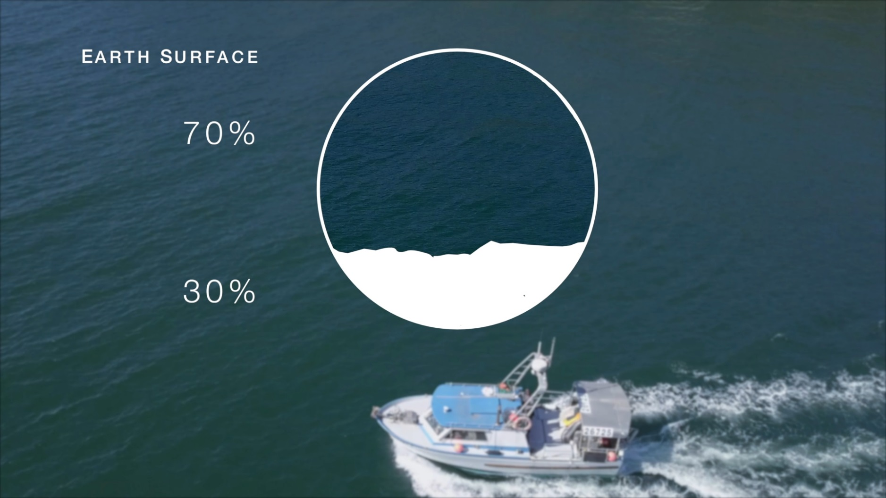
The ocean is too large to ignore
Should it not be Planet Ocean?
Source: http://www.environment-prize.com/laureates/by-year/2017/rashid-sumaila/
www.thehindu.com
Notes:
‹#›

Slide 4
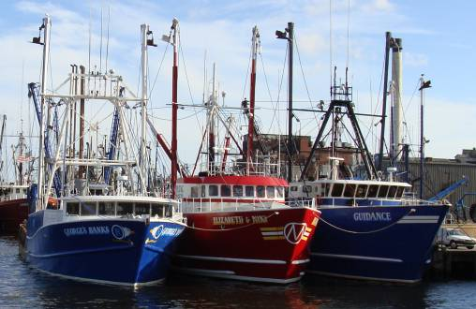
Human-Ocean interaction
The need for management and marine protection
Marine Environment
Fish Economy
Notes:
‹#›

Slide 5
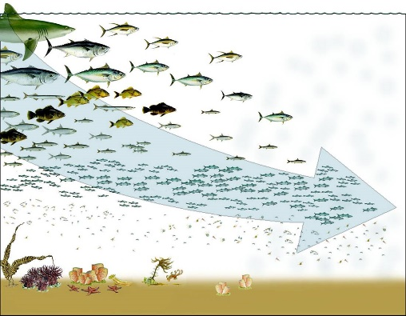
Overfishing as captured by fishing down marine food web (Pauly et al. 1998)
Notes:
‹#›

Slide 6
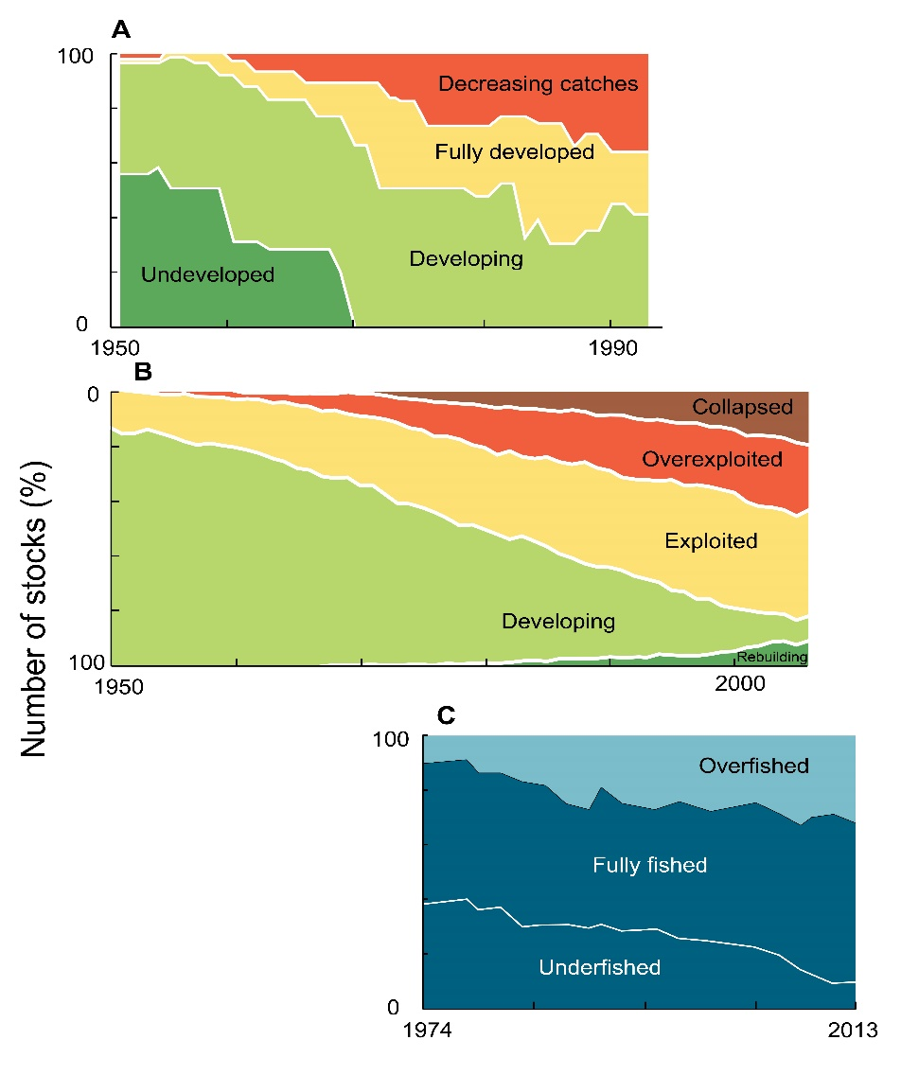
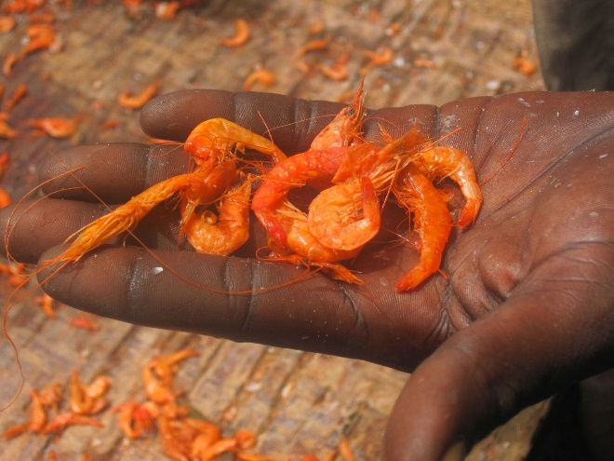
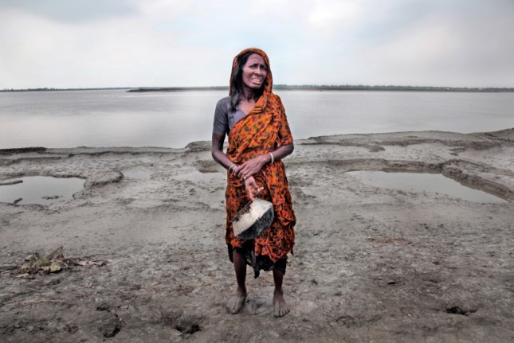
Declining oceans have serious human consequences

Slide 7
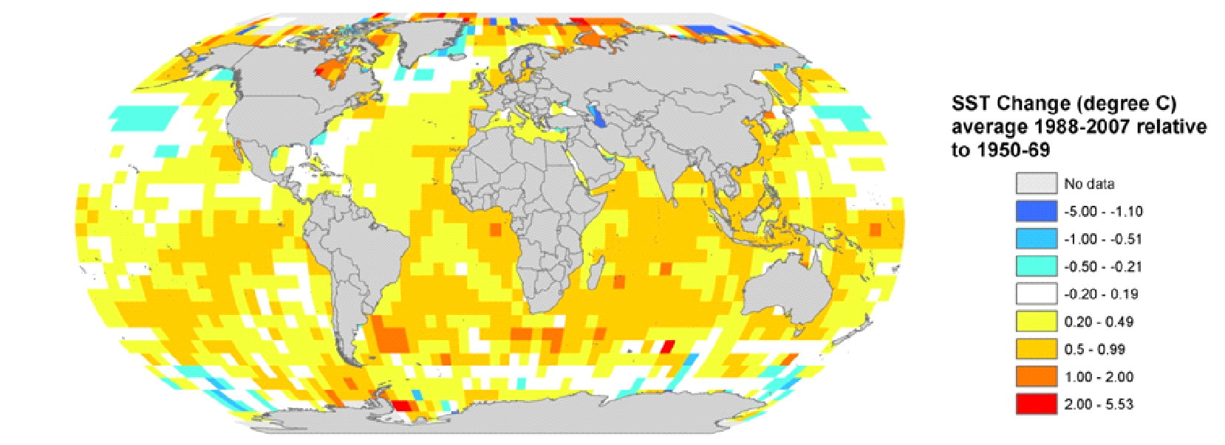
Ocean warming, acidification and deoxygenation
The ocean has become:
warmer (with the world struggling to limit the increase in average temperature to 2ºC into the future);
with less sea-ice (summer Arctic sea ice extent is decreasing at 7.4% per decade);
more acidic (acidity projected to triple in the future);
less oxygenated in some area, higher sea level.
Notes:
‹#›
- Empirical evidence and theory show that climate change affect ocean conditions which in turn affect the marine ecosystems through change in primary productivity and the ecology of the species. For example, it’s been observed that species shift their distribution ranges over the past few decades towards higher latitude region. This includes commercially important species such as cod in the North Sea. Ocean acidification may possibility have a major impacts on marine ecosystems. These will have an impacts on fisheries and biodiversity. For example, when I talked to fisheries managers in the west coast of the USA, they say that fishermen in the region found that fish have shift their distribution and the fishermen have to fish in area where they are unfamiliar with. But fishermen like to fish in familiar waters because they know the best fishing spots and because of safety reason. These would have direct ecological and socio-economic implications. Also, as species move their ranges, it will lead to changes in biodiversity patterns, and may lead to increase risk of extinction for some. These would then also have conservation implications. My research is try to quantify these impacts, in terms of ecology and socio-economy.

Slide 8
Fisheries implications of climate change
Changes in fisheries catch, fisheries economics, fisheries management, food security
Changes in community structure, trophic interactions, biodiversity
CLIMATE CHANGE
Temperature
Salinity
Hypoxia
Acidification
Changes in population growth, abundance, species distribution
Changes in body size, reproduction, primary productivity, habitats
Organism
Population
Community/
ecosystems
Fisheries
Adopted from Sumaila et al. (2011): Nature Climate Change
Notes:
Climate change is transforming the physical and chemical conditions that marine life has adapted to. A changing ocean has the potential to impact marine life from the organism level, to the ecosystem level. This will in turn affect the ecosystem services we as humans depend on, from providing food to regulating the global climate. In my thesis I will be addressing climate change impacts on populations, communities and fisheries.
‹#›

Slide 9
How an ocean full of life is also climate action

Slide 10
To end overfishing, policies & actions should be …
Positive Feedback
Marine
Conservation
People
Wellbeing
Two examples:
Subsidies
High seas protection
Negative Feedback
… designed to eliminate negative & promote positive feedbacks
Sumaila & Tai (2020): Frontiers in Marine Science

Slide 11
Concluding remarks
Ending overfishing now would:
strengthen the ocean, making it more capable of withstanding climate change; while contributing to mitigating climate change.
A healthy person is more likely to survive an epidemic than a person who is less healthy, and because of overfishing we have severely weakened the ocean’s immune system;
In this way people and the ocean are not that different.
Notes:
‹#›

Slide 13
Thanks for your attention!
and
Thanks to Our Fish for making this work possible
Notes:
‹#›

